Slide 1
DNA Replication in Prokaryotes & Eukaryotes
Part 2

Slide 2
DNA Replication
A complex process whereby the 'parent' strands of DNA in the double helix are separated, and each one is copied to produce a new (daughter) strand
Before a cell divides, it must first copy (or replicate) its entire genome so that each resulting daughter cell ends up with its own complete genome

Slide 3
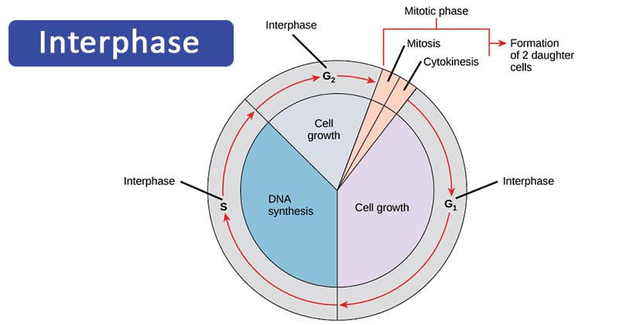



Basic Info
DNA contains all information of human
Before any cell division, a cell must duplicate all its DNA
Replication occurs during the S phase of the cell (S-phase means Synthesis phase of interface)
DNA Replication takes place in S phase

Slide 4
Cont,
Replication of DNA means making a replica(an exact or identical copy)
DNA replication is the process of making an exact copy of DNA by using one of the parent DNA strands as a template
DNA functions are:
Store genetic information & transfer it to the daughter cell during mitosis by replication
Transfer of genetic information from DNA to RNA to be expressed as proteins

Slide 5
The outcome of DNA replication?
DNA replication outcome in two identical daughter molecules each consisting of one old(original)strand and one newly-synthesised strand. The point where separation of the DNA occurs is called Replication Fork

Slide 6
Annex of Replication
Unwinding - forms a Replication Fork
Primase – Synthesis of RNA primer
Continuous Synthesis – Leading Strand
Discontinuous Synthesis – Lagging Strand(Okazaki fragments)
Synthesis in 5’ -> 3’ direction
Primers removed, nick sealed
Proof Reading – by DNA polymerase’
Organized into chromatin Structure

Slide 7
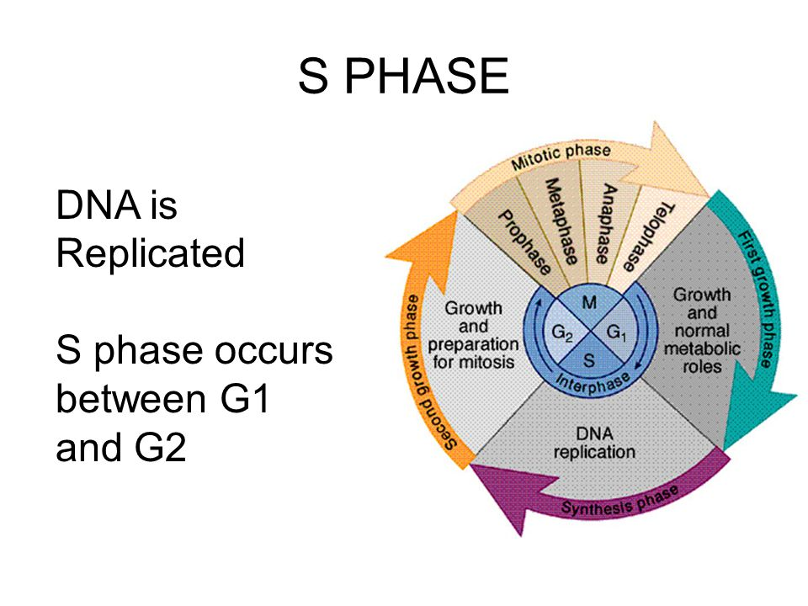
When & where DNA replication takes place? Synthesis Phase (S Phase)
S phase during interphase of the cell cycle
Nucleus of Eukaryotes
Inside the cytoplasm of Prokaryotes

Slide 8
What is the rate and how long it take to replicate human DNA?
The typical human chromosome has about 150 million base pairs that the cell replicates at the rate of 50 pairs per second. At that speed of DNA replication, it would take the cell over a month to copy a chromosome.
The fact that it takes only one hour is because of multiple replication origins

Slide 9
Some History Discovery of DNA Replication?
Matthew Meselson and Franklin Stahl's experiments on the replication of DNA, published in PNAS in 1958 , helped boost the concept of the double helix. Also, it supported the hypothesis that DNA replication was semiconservative

Slide 10
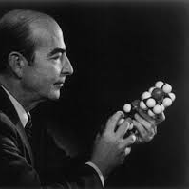
Arthur Kornberg
In 1955 he worked on E. Coli
Discovered the mechanisms of DNA Synthesis
They required 4 components :
dNTPS’s :- dATP, dTTP, dGTP, dCTP
DNA template strand
DNA Polymerase (It is also a Kornberg enzyme)
Mg (which optimizes DNA polymerase activity)

Slide 11
Some of Models for DNA Replication
There are many hypotheses to explain the process of replication
Some of them are:
Conservative Model
Semi Conservative Model
Dispersive Model

Slide 12
Modes of DNA Replication
There are 3 Possible modes of DNA Replication
Dispersive: In the dispersive mode of replication, the old DNA molecule would break into several pieces, each fragment would replicate and the old and new segments would recombine randomly to yield the progeny of the DNA molecule.
Each progeny molecule would have both old and new segments along its length

Slide 13
2. Conservative
According to conservative scheme, the two newly synthesised strands following the replication of a DNA molecule would associate to form one double helix, while the other two old strands remain together as one double helix.

Slide 14
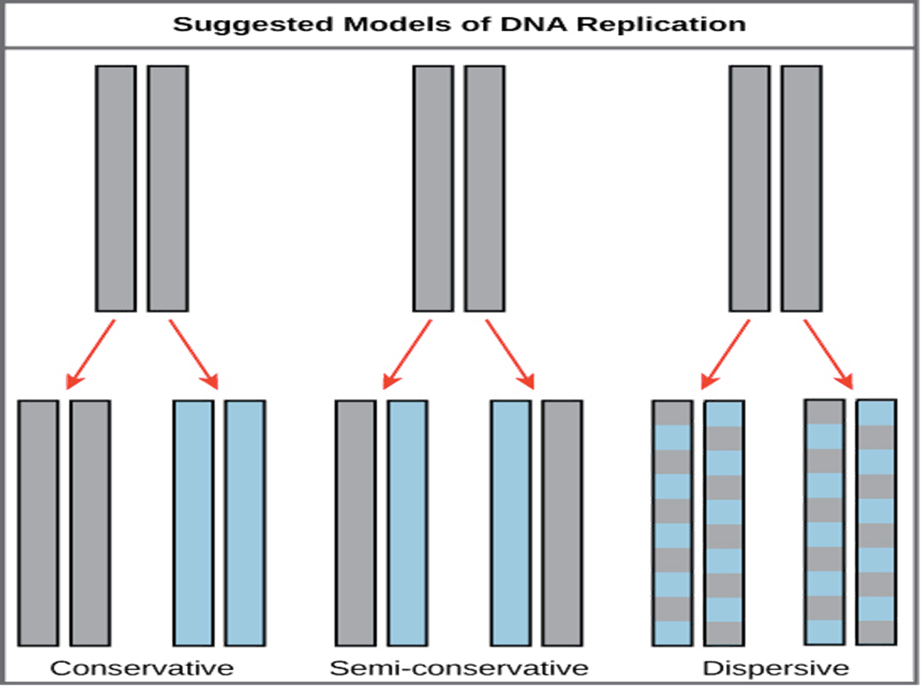
Modes

Slide 15
3. Semi-conservative Replication
It was proposed by Watson and Crick
In this method both the strands of Parental DNA separate from one another
Each old strand synthesizes a new strand
Each of the two resulting DNA molecules has one parental and one new strand

Slide 16
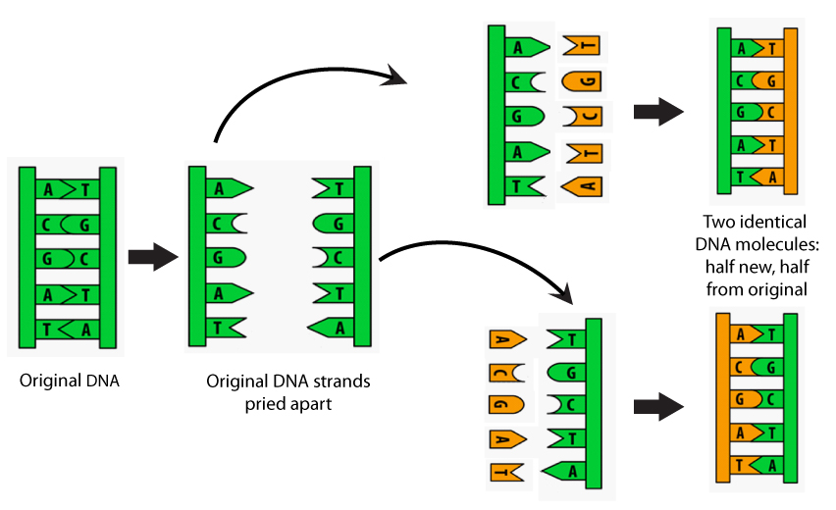
semi

Slide 17
Proof for Semi-conservative Replication
There are 2 important experiments which support that DNA replication is semi-conservative
1. Meselson & Stahl experiment
2. Taylors Experiment

Slide 18
Meselson and Stahl Experiment in 1957
They grew E.Coli on medium containing N15 for several generation. So that the nitrogen present in DNA bases of these cells was N15
DNA having N15 has a detectable higher density than that having N14. therefore they are called heavy and light DNA respectively.
Heavy and light DNA’s can be readliyseperated through equilibrium density gradient centrifugation. There form distinct bands in the centrifuge tube.

Slide 19
Experiment
Meselson and Stahl transferred the E.Coli cells grown on N15 medium to 2’s medium containing normal N14
They withdraw samples from these E.coli cells after the approximately 1,2, 3 cell generations
DNA from those cell samples was isolated and subjected to density gradient centrifugation
The results obtained are as follows

Slide 20
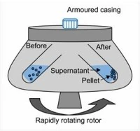
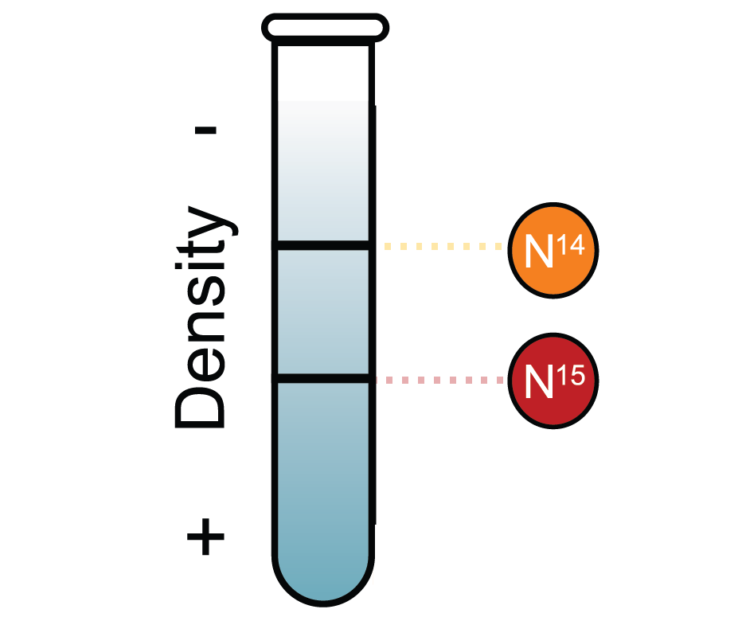
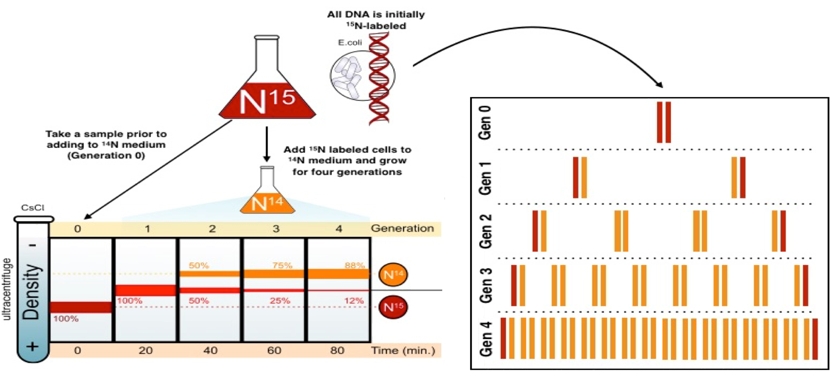
The Meselson-Stahl experiment
Isoptope N15-I14 → Neutrons

Slide 21
Process of Exp
After one Generation: The resultant DNA molecule would have one heavy(having N15) and one light(having N14) strand. Therefore these DNA molecules would have intermediate density. Forms Intermediate band.
After two generations: formed two types of DNA molecules. Half of these have an intermediate density(means having one heavy and one light strand), and the remaining half would have a light density(both light strands). Forms one intermediate band and one light band.
After 3rd generation: the intermediate density DNA molecules would yield half intermediate and half light molecules, while all the molecules obtained from replication of the light DNA would be light

Slide 22
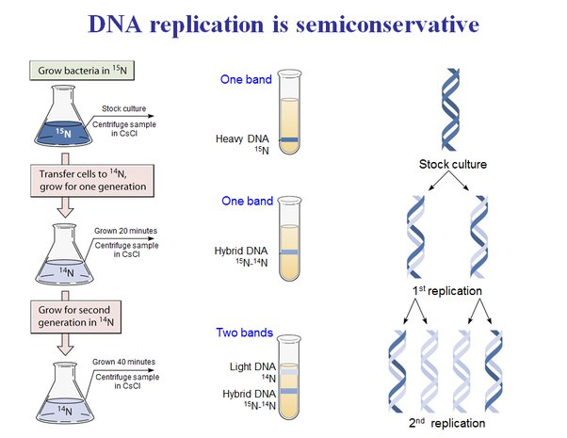
Generation

Slide 23
2. Taylors Experiment
In 1969 Taylor conducted his experiments with root tip cells of viciafaba
He treated root tips with radioactive thymidine to label the DNA
Root tips were grown in the normal medium
In the first generation both chromatids were labelled
In the second generation of cell division, one chromatid of each chromosome was labelled and one was normal
This demonstrated a semi-conservative mode of replication
The DNA replication is associated with chromosome replication

Slide 24
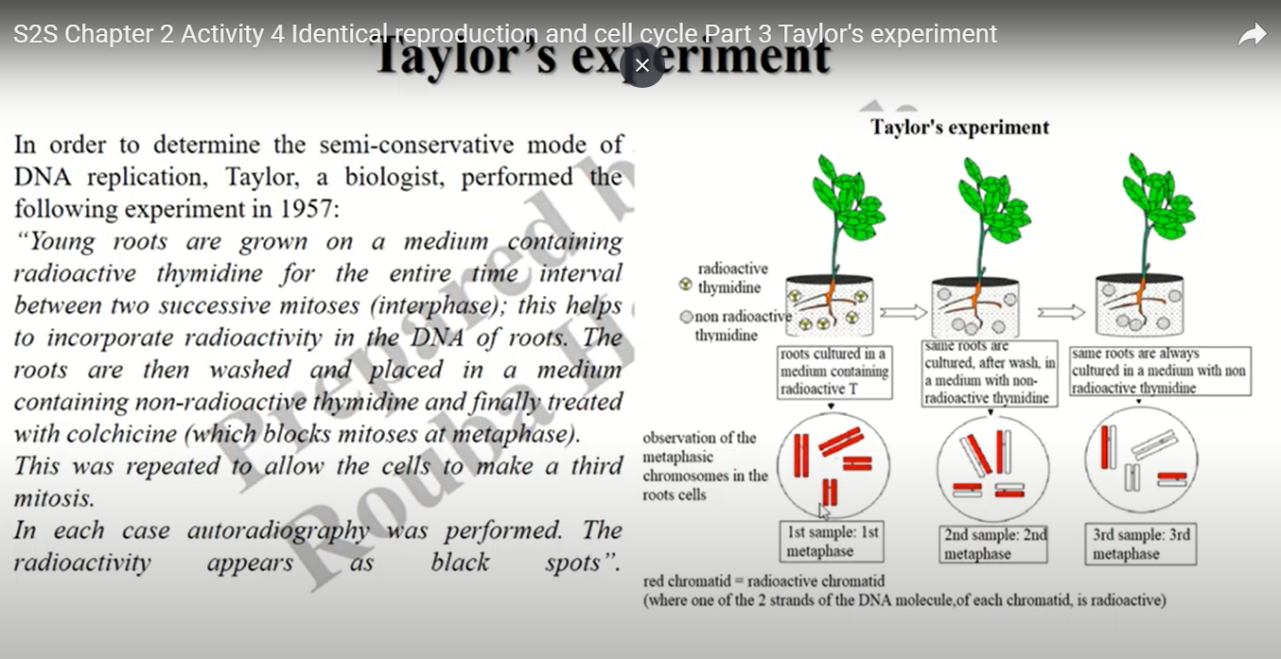

Slide 25
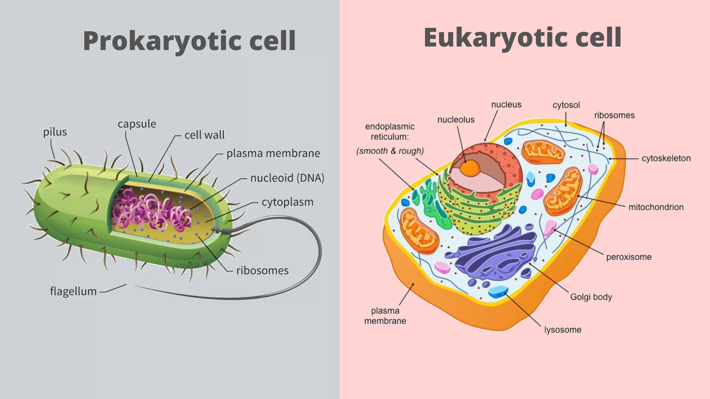
Prokaryotic Cell v/s Eukaryotic Cell
Prokaryotic Cell | Eukaryotic Cell
Prokaryotic Cells are quite simple in structure. They have no nucleus, no organelles and a small amount of DNA in the form of a single, circular chromosome | Eukaryotic cells, on the other hand, have a nucleus, multiple organelles in multiple, linear chromosomes

Slide 26
Some of the similarities between Pro & Eukaryotic cells
The process or steps for DNA replication are generally the same for all prokaryotic and eukaryotic organisms
Unwinding the DNA is accomplished by an enzyme named DNA helicase
Manufacturing the new DNA strands is orchestrated by enzymes called polymerases
Generally, in both pro and Eukaryotes, the process of DNA replication proceeds in two opposite directions, from the origin of replication
Both types of organisms also follow a pattern called semi-conservative. In this pattern, the individual strands of DNA are manufactured in different directions, producing a leading and lagging strand.
Lagging Strands are created by the production of small fragments called Okazaki fragments that are eventually joined together.

Slide 27
Cont,
Both type of organisms also begin new DNA strands with small primer of DNA

Slide 28
Location
Prokaryotes | Eukaryotes
Prokaryotes do not have nucleus and other membrane-bound organells, like mitochondria, endoplasimic reticulum, and golgi bodies. The prokaryotic DNA is present as a DNA-protein complex called nucleoid. The replication occurs in the cytoplasm of the cell | In eukaryotes, the organisms that contain a membrane-bound nucleus, the DNA is inside the nucleus. Hence, the nucleus is the site for DNA replication in eukaryotes.

Slide 29
Where Cell Division occur?
Prokaryotes | Eukaryotes
In prokaryotes, DNA replication is the first step of cell division, which is primarily through binary fission or budding | In eukaryotes, cell division is a comparatively complex process and DNA replication occurs during the synthesis(S) phase of the cell cycle

Slide 30
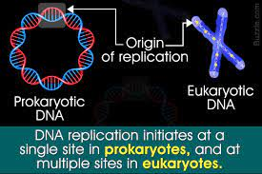
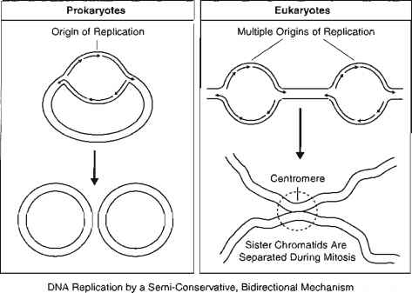
Replication origin single & Multiple sites?
Prokaryotes | Eukaryotes
In prokaryotes, a single replication site is present in the circular DNA molecule | In eukaryotes, multiple replication sites are present in a single DNA molecule

Slide 31
Enzyme & Protein
Only Specific Enzyme to Prokaryotes
Only Specific Enzyme to Prokaryotes
Only Specific Enzyme to Prokaryotes
Enzyme | Activity or process
DNA Polymerase I | 5’ to 3’ polymerase, 3’ to 5’ exonuclease, 5’ to 3’ exonuclease
DNA Polymerase III | 5’ to 3’ polymerase, 3’ to 5’ exonuclease
Greek Letters
------------------
Alpha 1
Beta 2
Gamma 3
Delta 4
Epsilon 5
Enzyme | Activity or process
DNA Polymerase Alpha | 5’ to 3’ Polymerase
DAN Polymerase Delta | 5’ to 3’ polymerase, 3’ to 5’ exonuclease
DNA Polymerase Epsilon | 5’ to 3’ polymerase

Slide 32
Steps in Rep’n
Steps in Replication | Prokaryotic Cells | Eukaryotic Cells
Recognition of origin of replication | DNA A protein | Unkown
Unwinding of DNA double helix | Helicase(requires ATP) | Helicase(requires ATP)
Stabalization of unwound template strands | Single stranded DNA –Binding Protein (SSB) | Single Stranded DNA-binding Protein(SSB)
Synthesis RNA primers | Primase | Primase
Synthesis of DNA Leading Strand Lagging Strand | DNA Polymerase III DNA polymerase III | DNA polymerase Delta DNA polymerase Alpha
Removal of RNA primers | DNA polymerase 1 (5’ -> 3’ exonuclease) | Unknown
Replacement of RNA with DNA | DNA polymerase I | Unkown
Joining of Okazaki fragments | DNA ligase(require NAD) | DNA ligase(requires ATP)
Remoival of +ve supercoils ahead of advancing replication forks | DNA topoisomerase II (DNA gyrase) | DNA topoisomerase II

Slide 33
Bubble in replication Replication Fork
Prokaryotic Cell | Eukaryotic Cell
One replication is formed during DNA replication | Numerous replication bubbles are formed in one replicating DNA molecule
Prokaryotic cell | Eukaryotic CellOn
Only two replication fork formed in each replicating prokaryotic chromosome, as DNA replication is bidirectional | A number of replication forks are formed simultaneously in each replicating DNA

Slide 34
Okazaki Fragments
Prokaryotic Cell | Eukaryotic Cell
Prokaryotic Okazaki fragments are longer, with the typical length observed In Escherichia Coli(E. Coli) being about 1000 to 2000 nucleotides | The length of eukaryotic Okazaki ranges between 100 and 200 nucleotides. Although comparatively shorter, they are produced at a rate slower than observed in prokaryotes
Termination
Prokaryotic cell | Eukaryotic cell
In prokaryotic, a single termination site is a present midway between the circular chromosome. The two replication forks meet at the site, thus, halting the replication process | In eukaryotes, the linear DNA molecules have several termination sites along the chromosome, corresponding to each origin of replication

Slide 35
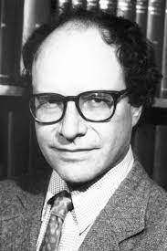
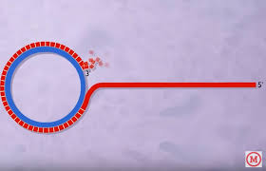

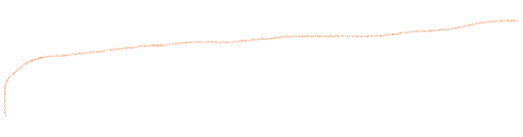
Rolling circular Model of DNA Replication
Gilbert and Dressier(1969) described the rolling circle model to explain reactivation in ssDNA viruses

Slide 36
Rolling
Rolling Circle Replication describes a process of Unidirectional Nucleic Acid Replication that can rapidly synthesize multiple copies of circular molecules of DNA or RNA, such as plasmids, the genomes of bacteriophages and the circular RNA genome of viroid's
Some Eukaryotic Viruses also replicate their DNA via the rolling circle mechanism. Usually under the name Rolling Circle Amplification,
The mechanism used in the Lab of Molecular Biology and Nanotechnology

Slide 37
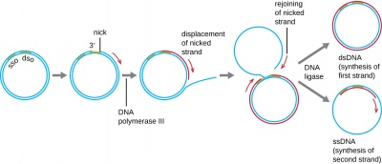
Rolling Circle has 5 steps:
DNA will be nicked(Cut slightly)
The 3’ end is elongated using “unnicked” DNA as the leading strand(template), 5’ end is displaced
Displaced DNA is a lagging Strand and is made double-stranded via a series of Okazaki fragments
Replication of both “unnicked” ad displaced DNA completes
Displaced DNA circularizes

Slide 38
3 Basic Steps Involved in rolling circular Model
1. Initiation
2. Elongation
3. Termination

Slide 39
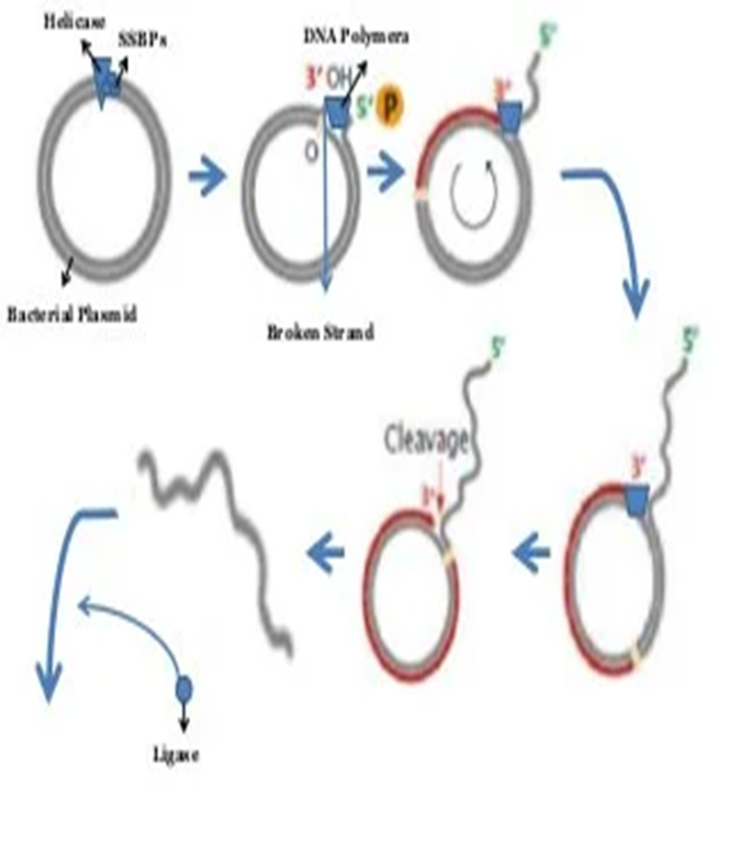
1. Initiation
Rolling circle DNA replication is imitated by an initiator protein called Rep-A Protein encoded by the plasmid or bacteriophage DNA, which nicks one strand of the double-stranded, circular DNA molecule at a site called the Double-Strand Origin, or DSO
The initiator protein remains bound to the 5’ phosphate end of the nicked strand and the free 3’ hydroxyl end is released to serve as a primer for DNA synthesis by DNA polymerase III

Slide 40
Cont,
Producing free 3’ - OH and 5’ – Phosphate ends, by the action :
Helicase : - Is in hexameric form. Also called DNA-b Protein
Topoisomerase :- use toa void breakage O the DNA strand due to stretching
Single Strand Binding Protein(SSBPs) :- To avoid the rezipping of the DNA strand

Slide 41
2. Elongation
For elongation the DNA polymerase III binds to the 3’ – OH group of the broken strand, using the unbroken strand as a template.
The polymerase will start move in a circular form, due to which it is named as Rolling circular Model.
As the elongation proceeds, the 5’ end will grow out like a waving thread

Slide 42
Cont,
Displacement of the nicked strand is carried out by a host-encoded helicase called PcrA(plasmid copy reduced) in the presence of the plasmid replication initiation protein
Continued DNA synthesis can produce multiple single-Stranded linear copies of the original DNA in a continuous head-t-tail series called Concatemer

Slide 43
3. Termination
At the point of termination the linear DNA molecule cleaved from the circle resulting in a double-stranded DNA molecule and a single-stranded linear DNA molecule
The linear single-stranded molecule is circularized by the action of Ligase and then replication to a double-stranded circular plasmid molecule

Slide 44

Cont,
Linear copies can be converted to double-stranded circular molecules through the following process:
First, the initiator protein makes another nick to terminate the synthesis of the first(leading) strand.
RNA polymerase and DNA polymerase III then replicate the Single-stranded origin(SSO) DNA to make another double-stranded circle.
DNA polymerase I removes the primer, replacing it with DNA, and DNA ligase joined the ends to make another molecule of double-stranded circular DNA

Slide 45
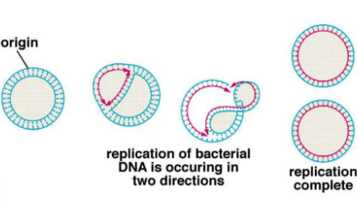
Replication In Prokaryotes

Slide 46
DNA polymerase Family
There are 5 different DNAPs reported in E.Coli
DNAP I: functions in repair and replication
DNAP II: functions in DNA repair(reported in 1999)
DNAP III: principal DNA replication enzyme
DNAP IV: functions in DNA repair (1999)
DNAP V: functions in DNA repair (discovered in 1999)

Slide 47
DNA polymerase Types
1. DNA Polymerase Alpha: Synthesis of aligning strand & gap filling
2. DNA Polymerase Beta: DNA repair
3. DNA Polymerase Gamma: Mitochondrial DNA synthesis
4. DNA Polymerase Delta: Synthesis of Leading Strand
5. DNA Polymerase Epsilon: DNA repair
There are 14 different DNA polymerases have been reported in Eukaryotes

Slide 48
DNA Features
It is semiconservative
Semidiscontinious
Okazaki fragments
bidirectional

Slide 49
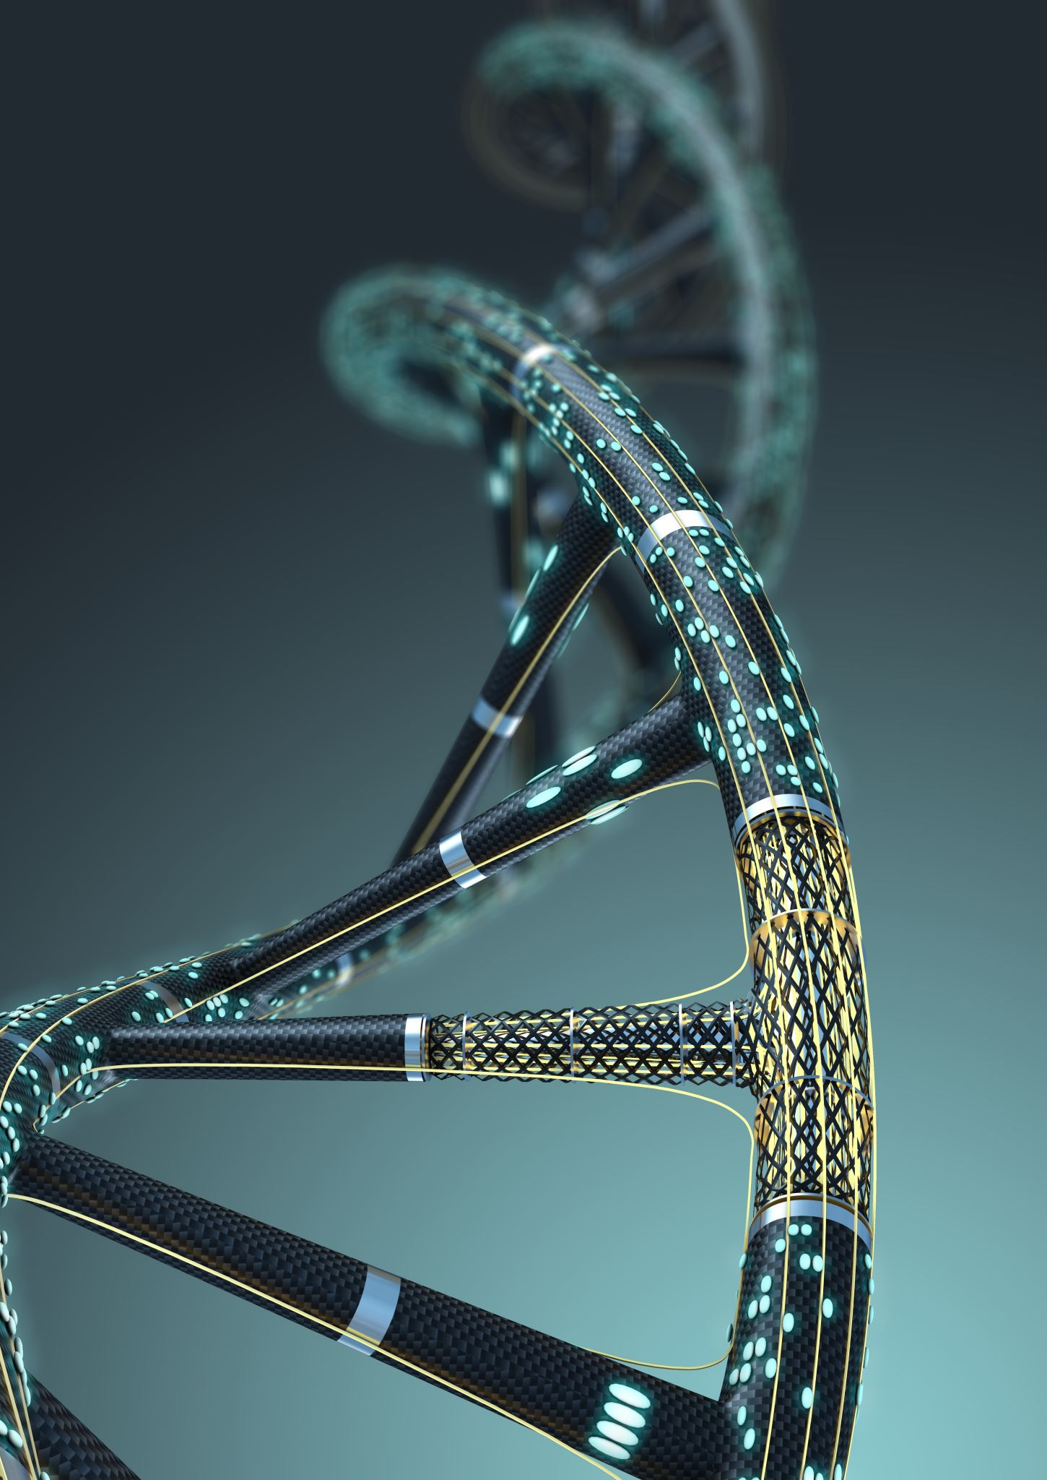
Topoisomerase Type I
Precedes replicating DNA
Mechanism
Makes a cut in one strand and passes another strand through it. Seals gap.
Result outcome: Supercoiling as strands are separated, allows replication machinery to proceed

Slide 50
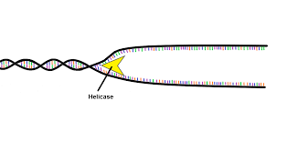
Helicase
Operates in Replication Fork
Separated strands to allow DNA polymerase to function on single strands
Translocate along single strain in 5’ -> 3’ or 3’ -> 5’ direction by hydrolysing ATP

Slide 51
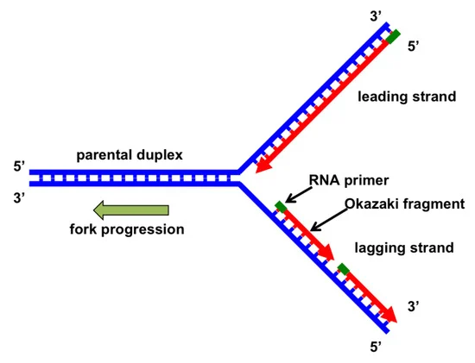
Some of main Steps

Slide 52
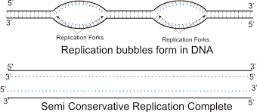


Strand Separation
Replication starts at multiple origins in Eukaryotic cells
DNA helicase cause unwinding of the duplex DNA from both sides
DNA topoisomerases relax the supercoiled DNA ahead of the replication fork
Proceeds in both directions
Replication Point

Slide 53
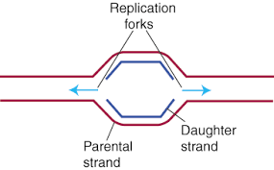
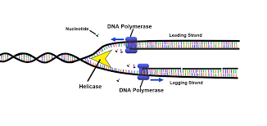
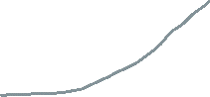
2 forks
2 DNA strands are separated
SSB protein stabilize the single Stranded DNA
Two DNA Strand from replication forks was created
Each strand acts as template strand
Replication proceeds from 5’ to 3’ end
2 replication forks in DNA
Replication fork

Slide 54
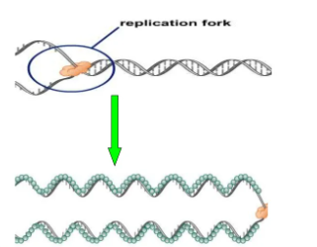
Formation of replication fork and SSBs bind to stabilize ssDNA

Slide 55
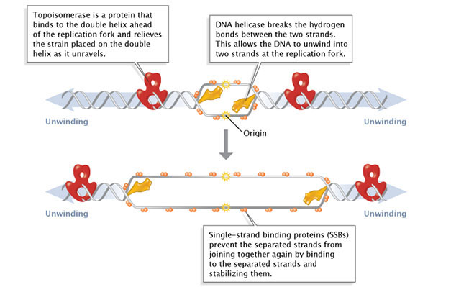
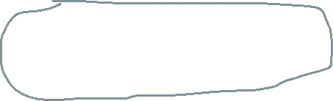
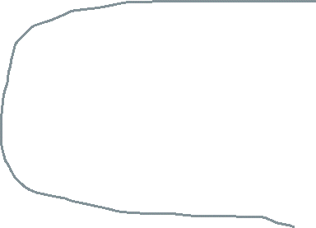
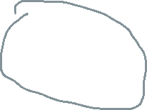
DNA helicase unwind the double helix

Slide 56
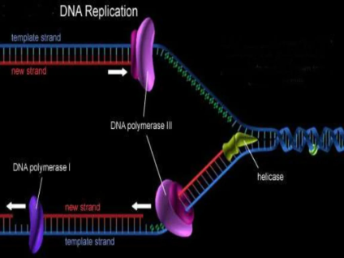
DNA rep

Slide 57
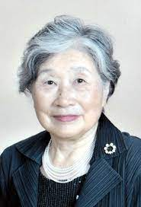
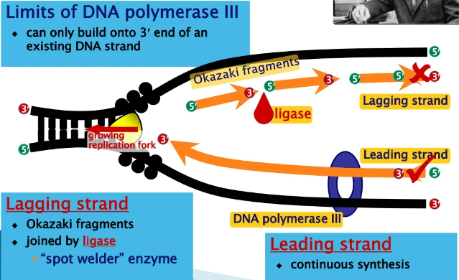

Leading & Lagging strand

Slide 58
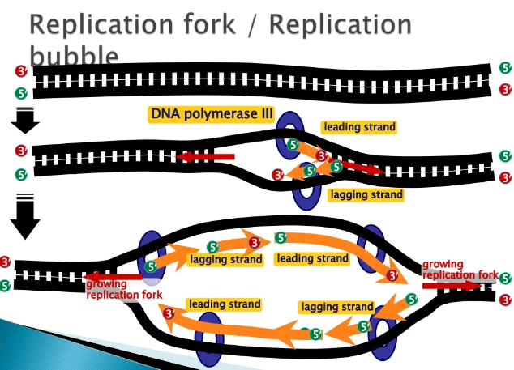













Replication Fork

Slide 59
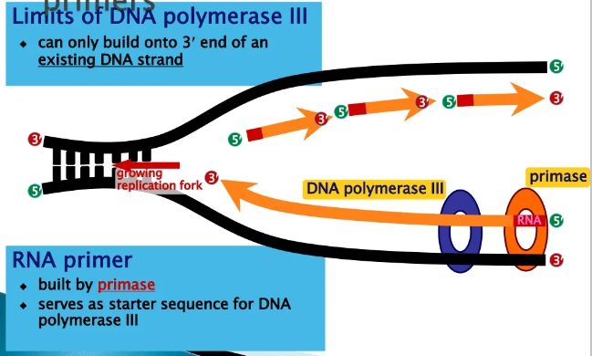
Started DNA synthesis – DNA Primers

Slide 60
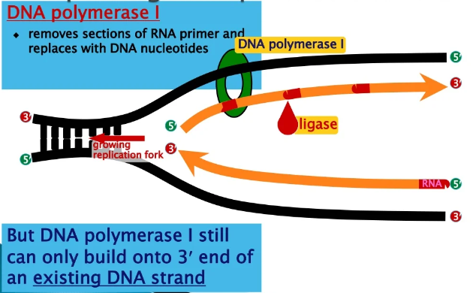
Replacing RNA primers with DNA

Slide 61
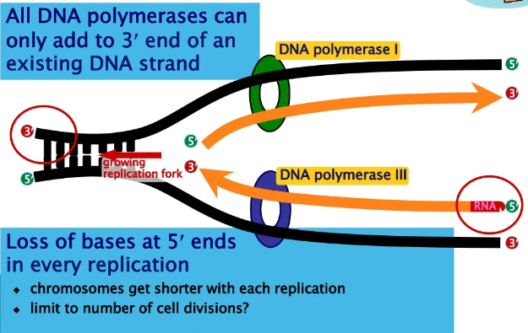
Chromosome erosion

Slide 62
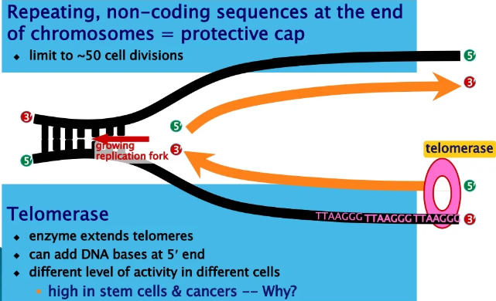

Telemeres
In both scenarios (telomere shortening and telomere replication stress), telomerase activation can restore telomere function. As a cell begins to become cancerous, it divides more often, and its telomeres become very short. If its telomeres get too short, the cell may die. Often times, these cells escape death by making more telomerase enzyme, which prevents the telomeres from getting even shorter

Slide 63
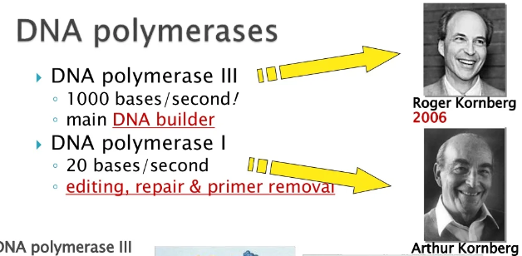
DNA polymerases

Slide 64
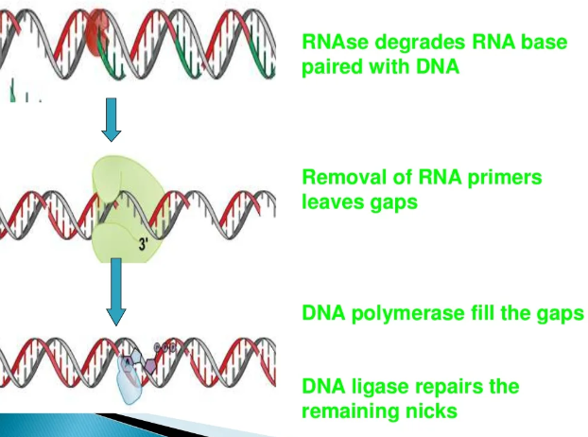
Steps of rna base, gaps fill and repirs

Slide 65
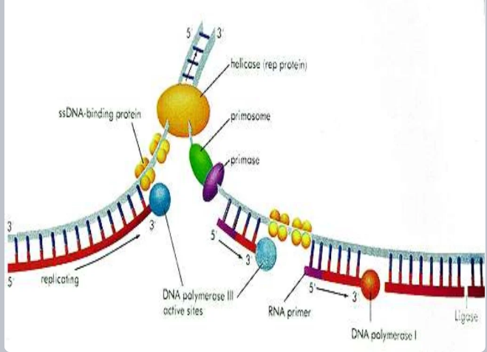
Cont,

Slide 66
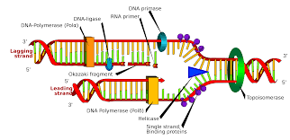
DNA final

Slide 67
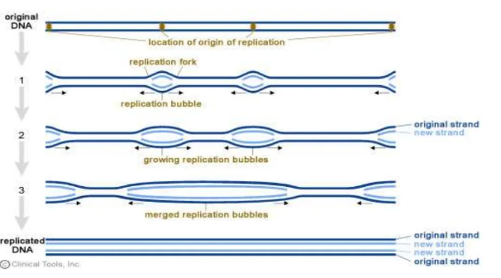

Slide 68
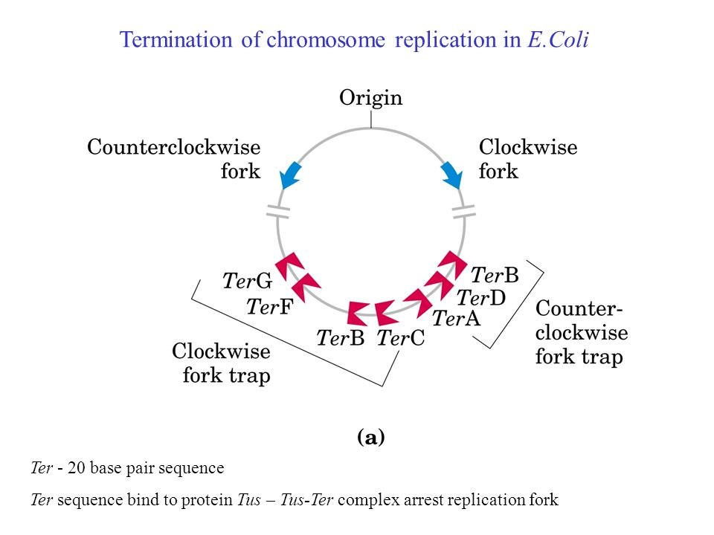
Termination of DNA replication
Tus Protein arrests replication fork motion
Termination of DNA replication in E. coli is completed through the use of termination sequences and the Tus protein. These sequences allow the two replication forks to pass through in only one direction, but not the other.

Slide 69
Replication in Eukaryotes

Slide 70
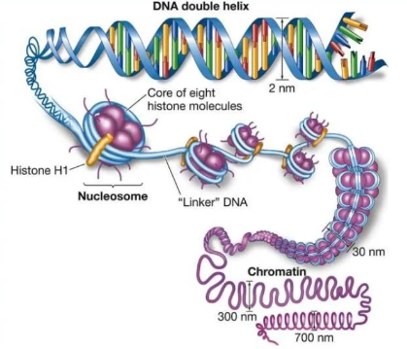
Chromosomes in Eukaryotic Cells consist of
DNA
Protein
Some Chromosomal RNA

Slide 71
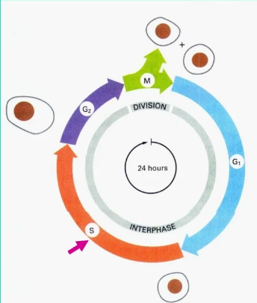
Cell cycle
G1 – Preparing for DNA replication (cell growth)
S – DNA Replication
G2 – A short gap before Mitosis
M – mitosis and cell division

Slide 72
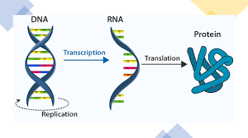
It is also Semi-conservative replication

Slide 73
Differences
Feature | Prokaryote | Eukaryote
Location | Occurs iside the cytoplasm | Occurs inside nucleus
ori | One origin of replication per molecules of DNA | Have many origins of replication in each chromosome
Ori length | 100-200 or more nucleotides in length | About 150 nucleotides
Initiation elemnt | Carried out by protein Dna and DnaB | Carried out by the origin recognition complex
DNA Polymerase | I, II, III | Alpha, beta gamma, delta , epsilon

Slide 74
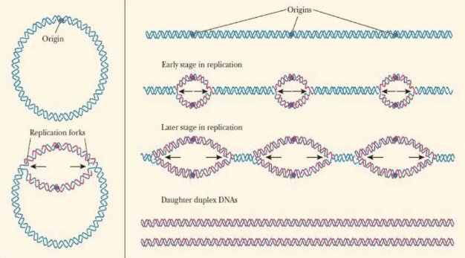

Slide 75
Basic steps of replication in EUK
Semi-conservative
Starts at the ‘origin’
Semi-discontinuous
Synthesis always in the 5’ -> 3’ direction
RNA primers required
In humans occurs at the rate of 3000 nucleotide/min
In bacteria cells it occurs at the rate of 30,000 nucleotide/min

Slide 76
Some important process in eukaryotes
DNA Polymerases Alpha, Beta, Epsilon, Gamma
Helicase
Topoisomerase
Primase
Ligase
SSB Proteins
dNTPs, Mg, ATP

Slide 77
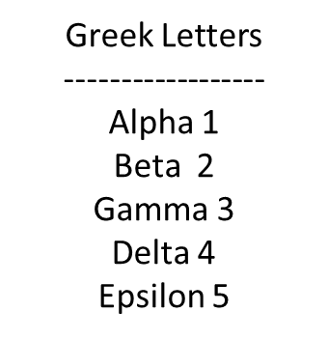
Role of protein in Euk
Protein | Role
DNA Helicase | Unwinds the double helix
RNA primase | Synthesises RNA primers
Single-stranded binding proteins | Keep the two strands separated
DNA polymerase Alpha | Add RNA primers during initiation
DNA polymerase Delta | Proofreading of DNA, add Okazaki fragments
DNA polymerase epsilon | Synthesis DNA ;Proofreading
DNA ligase | Joins the ends of DNA segments DNA pairs

Slide 78
DNA Polymerase Alpha
Involved in initiation
Synthesis of an RNA primer then adds dNTPs
A complex of 4 subunits 50-KD and 60-kD are primase subunits; 180-kD subunit DNA polymerase, Synthesizes 10-12 nucleotides RNA primers
Synthesizes RNA primers for the leading strands and each lagging strand fragments

Slide 79
DNA Polymerase Delta
The principal DNA polymerase, add Okazaki fragments in lagging strand
Role in proofreading
Consists of a 125kD and a ~50kD subunit
The 50kd subunit interacts with PCNA (proliferating cell nuclear antigen)

Slide 80
DNA Polymerase Epsilon
It catalyzes the replication of leading strand, also contributes to proofreading
DNA polymerase epsilon consists of more than one subunit,> 300kd
Polymerases delta & epsilon both consist 3’ -> 5’ exonuclease activity required for proofreading
DNA Polymerase Beta: Monomeric having 36-38kd involved in the DNA repair process
DNA Polymerase Gamma: The DNA replicating enzyme of mitochondria

Slide 81
Proteins involved in Eukaryotic DNA Synthesis
PCNA(proliferating Cell Nuclear Antigen) : Provide substrate for DNA Polymerase Delta, the eukaryotic counterpart of the sliding clamp of E.coli PCNA also encircles the Double helix
RPA :
ssDNA – binding protein that facilitates the unwinding of the helix to create 2 replication forks, the eukaryotic counterpart of the SSB protein
RFC(Replication Factor C):
the eukaryotic counterpart of the complex Clamp Loader of E.coli is to PCNA on DNA

Slide 82
0RC & MCM
ORC(origin recognition complex):
Multisubunit protein binds to sequences within replicator interacts with two other proteins – CDC6 and CDT1 resulting in loading of MCM complex on DNA
MCM(Mini Chromosome Maintenance complex):
Heterohexamer(MCM2-MCM7). Ring-shaped replicative helicase, once the MCM proteins have been loaded onto the chromatin, ORC and Cdc6 can be removed from there.

Slide 83
DNA Ligase
They are a class of enzymes that catalyse the formation of an alpha phosphodiester bond between two DNA chains
This enzyme binds the OH group at the 3’ end of the DNA strand to the phosphate group at 5’ end of the other
Linking the two fragments and completing replication of the region of the lagging strand

Slide 84
DNA REPLICATION
STAGES
INITIATION
ELONGATION
TERMINATION

Slide 85
Cont,
During initiation, proteins bind to the origin of replication while helicase unwinds the DNA helix and two replication forks are formed at the origin of replication
In Elongation, a primer sequence is added with complementary RNA nucleotides, which are then replaced by DNA nucleotides
During elongation, the leading strand is made continuously, while the lagging strand is made in pieces called Okazaki fragments
During termination, primers are removed and replaced with new DNA nucleotides and the backbone is sealed by DNA ligase

Slide 86
1.Initiation
To accomplish this, initiation is partitioned into two temporally discrete steps
Pre replication complex formation during the G1 phase
Activation of pre RC CDK and DDK enzymes in S phase

Slide 87
Cell Regulation
G1 phase of the cell cycle there are low levels of CDK activity
This allows for the formation of new pre-RC complexes
During the remaining phases of the cell cycle there are elevated levels of CDK activity
This inhibiting new pre-RC complex formation
At the transition of the G1 stage to the S phase of the cell cycle, S phase-specific cyclin-dependent protein kinase(CDK) and Dbf4 kinase(DDK) transform the pre-RC into an active replication fork

Slide 88


Slide 89

Steps in formation of pre-RC
Recognition of the replicator by the eukaryotic initiator, ORC(origin recognition complex)
Once ORC is bound, it recruits two helicase loading proteins Cdc6(cell division cycle 6 protein) and cdt1 (chromatin licensing and DNA replication factor 1 protein)
ORC and the loading proteins recruite eukaryotic replication protein i.e, helicase(the Mcm 2-7 complex)
Instead the pre-RC that are formed during G1 are only activated to initiate replication after cell pass from the G1 to the S phase

Slide 90

Cont,
Phosphorylation of these proteins results in the assembly to add additional replication proteins at the origin and the initiation of replication at the S phase
These new proteins include the three eukaryotic DNA polymerases
Then converted to the active CMG(Cdc45-MCM-GINS) helicase during the S phase
Once DNA pol alpha/ Primase synthesise an RNA primer and briefly extends it. Thus initiation of replication started

Slide 91

RFC
RFC(Replication factor c) recognizes primer-template junctions and loads PCNA(proliferating cell nuclear antigen at these sites)

Slide 92


Slide 93
Enzymatic Activity
Topoisomerases are responsible for removing supercoils head of the replication fork
Helicase unwind the strands at the fork
Pol Alpha is associated with an RNA primase Synthesizing a primer of 10 nucleotide stretch of RNA
Pol alpha for priming synthesis and elongated the newly formed primer with DNA nucleotides

Slide 94

The Eukaryotic Replication fork
The function of the replication fork in eukaryotes is maintained by the helicase activity
The separated polynucleotides are prevented from reattaching by SSBs protein
The main SSBs protein in eukaryotes is RPA

Slide 95

Elongation

Slide 96
Leading Strand Synthesis
Starts with the primase activity of DNA pol Alpha to lays down an RNA primer, then the DNA pol component of pol Alpha adds a stretch of DNA
RFC assembles PCNA at the end of the primer, PCNA displaces DNA Pol Alpha
DNA polymerase Delta or epsilon to PCNA at the 3’ end of the growing strand to carry out highly processive DNA synthesis Leading Strand synthesis
The DNA polymerase Alpha can extend the initial RNA primer with about 20 nucleotides of DNA but is not capable of lengthy DNA synthesis
After that DNA polymerase delta recognizes this primer and begins leading strand synthesis in 5’ -> 3; direction

Slide 97

Priming DNA Synthesis comparison between bacteria and Eukaryotes

Slide 98
Lagging Strand Synthesis
RNA primers synthesized by DNA polymerase Alpha, in the 5’ -> 3’ direction
DNA polymerases delta will synthesize short fragments of DNA called Okazaki fragments which are added to the 3’ end of the primer
Completion of lagging-strand synthesis requires removal of the DNA primer from each Okazaki fragments
To solve this problem there is two models for the competition of lagging strand synthesis in eukaryotes are described:
1. Rnase H model
2. Flap Model

Slide 99

Rnase H model Flap Model

Slide 100

DNA replication Annex

Slide 101
Cont,
Histone synthesis is continuous threw out a cell cycle but the most amount produced further S phase
Protein responsible for that are Nap-1 (Nucleosome Assembly Protein) having a role transporting or histone further om cytoplasm the to the nucleus
Another protein is CAF-1 (Chromatin assembly factor) which delivers histone to the site of replication

Slide 102
Replication takes place at telomeric ends Termination process
DNA Polymerase: can not replicate the end of lagging strand because polymerase requires 3’ OH and to bind at daughter strand. So it requires some additional enzyme to perform it.
Telomere :
1. Is G-C rich terminal portion of chromosome
2. Highly repetitive and conserved sequenced present in eukaryotes
Telomeric Sequence in
1. Mammals – TTAGGG 2. ARA-----
3. ----

Slide 103
Termination of Replication in Eukaryotes
Removal of the terminal primer at the end of lagging-strand synthesis leaves a small gap that cannot be filled in, if left unfixed, this gap leads to the loss of terminal sequences. This is known as the end replication problem. Telomerase(telomere terminal transferase) is a ribonucleoprotein that solves this problem
Telomerase contains protein and RNA which is complementary to the DNA sequence found in the telomeric repeat.
Telomerase extends the 3’ end of the parental chromosome beyond the 5’ end of the daughter strand
Telomeric repeat binding factors (TRF1) and (TRF2) bind to double-stranded telomeric DNA and have a role in telomere stabilization and telomere-length regulation. The protruding 3’ end can invade the duplex DNA and form a lariat-like structure called ‘t-loop’ establishing a protective cap

Slide 104


Slide 105
Some concepts related to Telemetric activity and Aging
Telomerase activity is repressed in the somatic cells of multicellular organisms, resulting in gradual shortening of the chromosomes with each cell generation, and ultimately cell death(related to cell aging)
This telomerase activity find in germ cells and absent in somatic cells, except in cancerous cells
In humans due to shortening of telomeric length cause inherited diseases of premature aging known as progerious occur in teenage
Aging is the sequential or progressive change in an organism that leads to an increased risk of debility, disease, and death

Slide 106
How Fast and Accuarate
E.coli takes <1 hour to copy 5 million bases pairs in its single chromosome
Human cell copies its 6 billion bases and divides into daughter cells in only a few hours with good accuracy
DNA polymerase initially makes about 1 in 10,000 base-pairing errors
Enzymes proofread and correct these mistakes
The new error rate for DNA that has been proofread is 1 in 1 billion base-pairing errors

Slide 107

Editing & Proofreading DNA
DNA polymerases are the enzymes that build DNA in cells. During DNA replication (copying), most DNA polymerases can “check their work” with each base that they add. This process is called proofreading. If the polymerase detects that a wrong (incorrectly paired) nucleotide has been added, it will remove and replace the nucleotide right away, before continuing with DNA synthesis

Slide 108

Mismatch repair
Many errors are corrected by proofreading, but a few slip through. Mismatch repair happens right after new DNA has been made, and its job is to remove and replace mis-paired bases (ones that were not fixed during proofreading). Mismatch repair can also detect and correct small insertions and deletions that happen when the polymerases "slips," losing its footing on the template
How does mismatch repair work? First, a protein complex (group of proteins) recognizes and binds to the mispaired base. A second complex cuts the DNA near the mismatch, and more enzymes chop out the incorrect nucleotide and a surrounding patch of DNA. A DNA polymerase then replaces the missing section with correct nucleotides, and an enzyme called a DNA ligase seals the gap

Slide 109
Cont,
One thing you may wonder is how the proteins involved in DNA repair can tell "who's right" during mismatch repair. That is, when two bases are mispaired (like the G and T in the drawing above), which of the two should be removed and replaced?
In bacteria, original and newly made strands of DNA can be told apart by a feature called methylation state. An old DNA strand will have methyl (CH3) groups attached to some of its bases, while a newly made DNA strand will not yet have gotten its methyl group^3
In eukaryotes, the processes that allow the original strand to be identified in mismatch repair involve recognition of nicks (single-stranded breaks) that are found only in the newly synthesized DNA^3

